Slide 1

Department of Data Science BEHAVIOURAL RISK CLASSIFIER - Machine Learning Algorithms to Classify Users Based on Online Behavior for Identifying Potential Risks
BATCH NO: A21
GUIDE NAME: DR.N.VIMALA
TEAM MEMBERS:
K. HARSHINI(2111CS030037)
G. KRANTHI VARMA(2111CS030048)
G. NIKESH(2111CS030065)
M. PRASUNA(2111CS030079)

Slide 2
Introduction
With the exponential growth of online activities, classifying users based on behavioral risks has become crucial for cybersecurity, fraud prevention, and personalized marketing. According to recent statistics, 82% of data breaches involved some form of human error or online behavior misuse, and cybercrimes targeting users rose by 50% in the past year alone. Despite the significance, current manual risk detection systems often struggle with real-time analysis and predictive accuracy. In this work, we propose a Behavioral Risk Classifier that uses Gradient Boosting Algorithm to classify the users into categories of "Safe" or "Risky" based on their online behavior. Our system employs preprocessing techniques such as data cleaning, splitting, normalization, and feature extraction to enhance the quality of input data. A machine learning (ML) model, specifically trained to detect patterns in user interactions, is used to predict potential risks. The model is capable of identifying subtle behavior deviations, allowing proactive risk management and improving user safety.

Slide 3
Literature Review
The field of Behavioral Risk Classification has evolved from traditional statistical methods to advanced machine learning techniques.
Earlier systems relied heavily on rule-based approaches and statistical models for identifying risky online behaviors.
Models like Decision Trees, Logistic Regression, and Naïve Bayes, which faced challenges in handling complex behavioral patterns and imbalanced datasets.
Faced challenges in accurately predicting intent for new user.
Limited applicability outside crisis situations.
As a result, many risks go undetected, and the lack of real-time intervention increases the chances of malicious activities or data breaches.

Slide 4

Objectives
The objective of the Behavioral Risk Classifier is to analyze users online behavior and categorize them as "Safe," or "Risky" using machine learning techniques.
This system enhances cybersecurity and fraud prevention by detecting subtle behavioral deviations for proactive risk management.

Slide 5
Existing System
Traditional user classification relies on manual methods or rule-based systems with predefined parameters like failed logins, IP changes, or abnormal transactions.
As a result, many risks go undetected, and the lack of real-time intervention increases the chances of malicious activities or data breaches.
Drawbacks
Slow Response Time
High False Positives
Human Error
Scalability Issues
Lack of Real-Time Adaptability

Slide 6

Proposed System
We suggest a Behavioral Risk Classifier that applies Gradient Boosting Algorithm to classify the users as "Safe" or "Risky" on the basis of their online activity.
The model takes user interaction data like browsing history, login frequency, transaction value, and time spent on websites as input.
Preprocessing processes such as data cleaning, normalization, and feature extraction improve input data quality for making accurate predictions.
This method enhances accuracy scales across millions of users, and offers timely interventions to decrease security weaknesses.

Slide 7
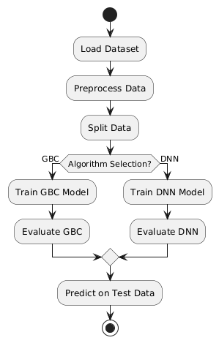
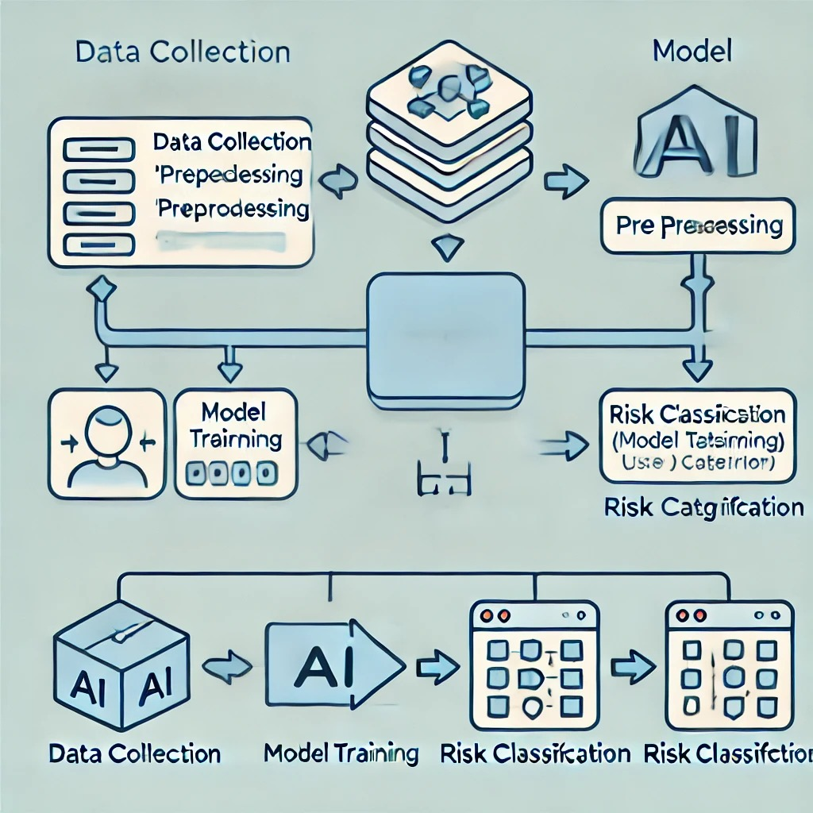
Block Diagram/Framework

Slide 8
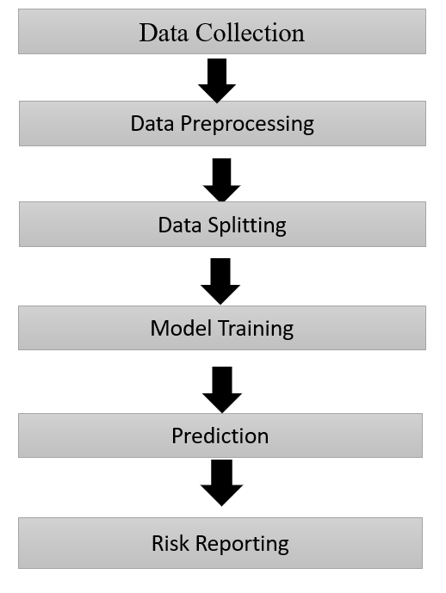
Methodology
Data Collection:
Collected user behavior data in .csv format.
Data Preprocessing:
Handled missing values using mean (numerical) and mode (categorical).
Encoded categorical features with LabelEncoder().
Applied SMOTE for data balancing and PCA for dimensionality reduction.
Model Training:
Trained models: Gradient Boosting and DNN.
Hyperparameter Tuning:
Used Optuna for improved accuracy by tuning key parameters.
Evaluation:
Assessed performance using Accuracy, Precision, Recall, and F1 Score.
Deployment:
Saved optimized models using joblib for future predictions.

Slide 9
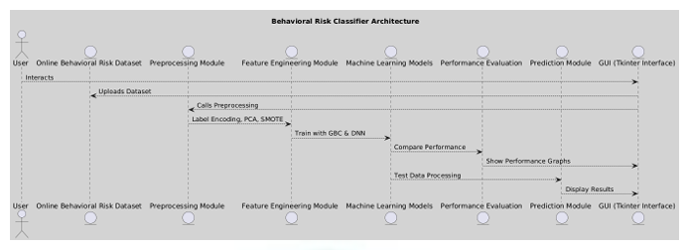
Algorithms
Gradient Boosting Classifier (GBC)
An ensemble technique that combines weak learners
(decision trees) to build a strong predictive model.
Efficient for handling complex patterns and improving
accuracy.
Deep Neural Network (DNN)
Utilized a multi-layered architecture with Dense layers
and ReLU activation.
Effective for complex feature extraction and
identifying hidden patterns.

Slide 10
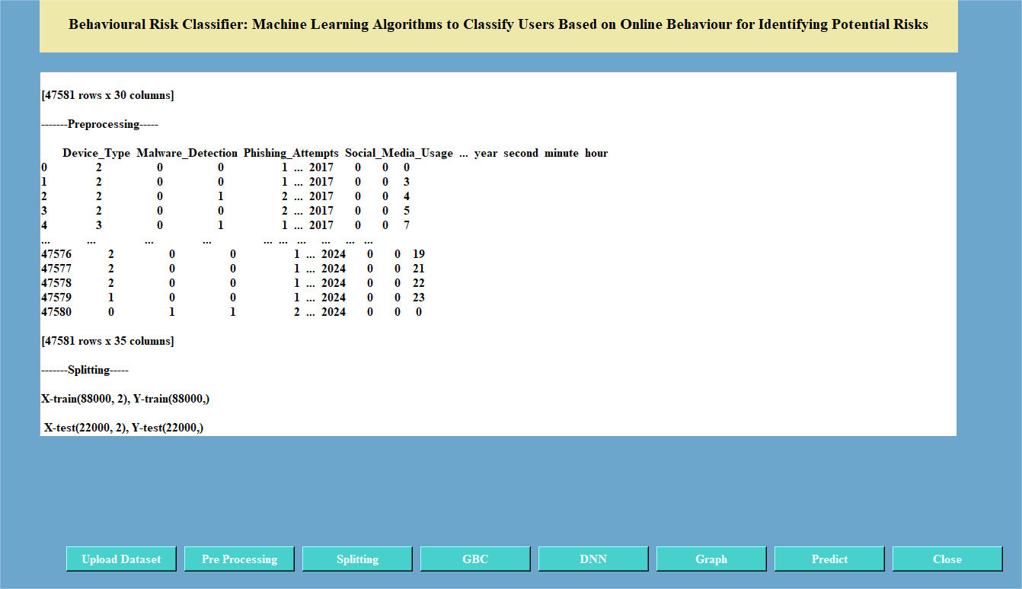
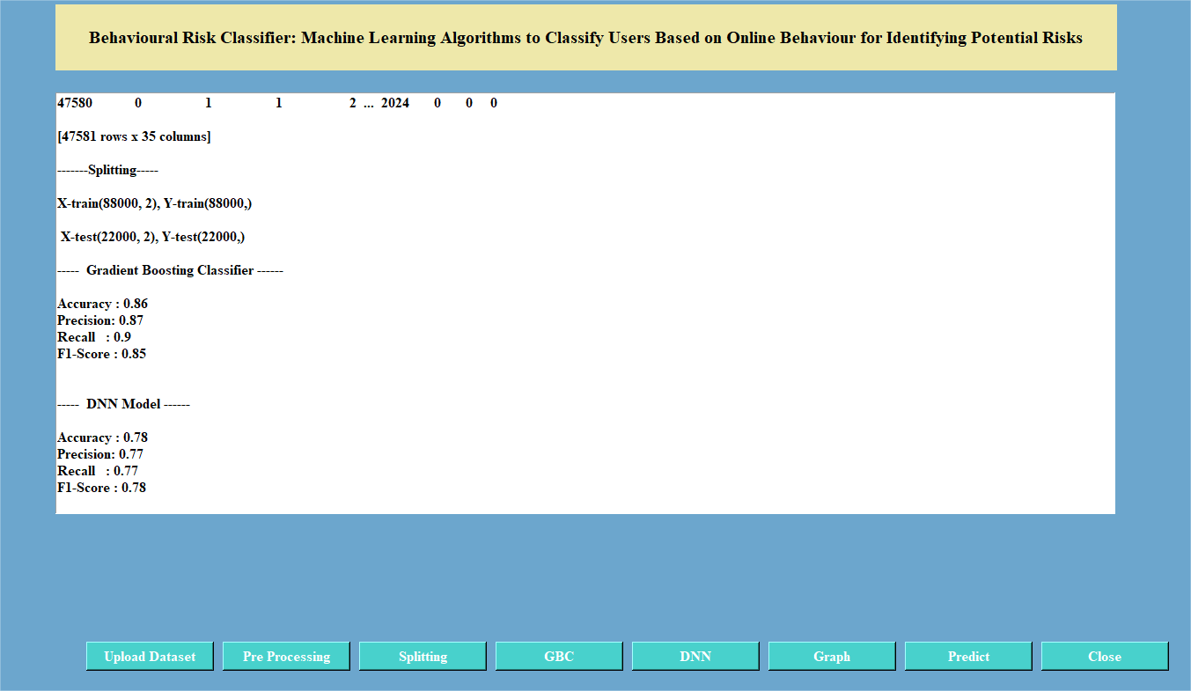
Results

Slide 11
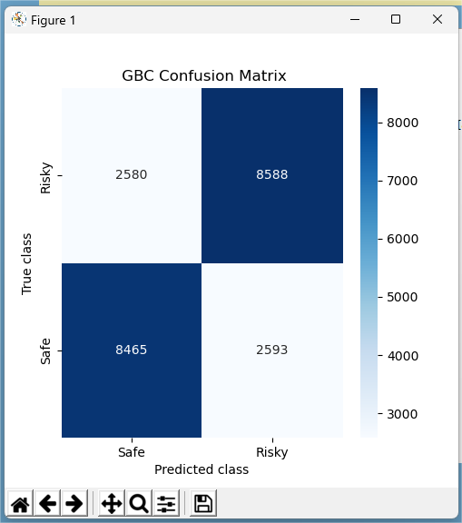
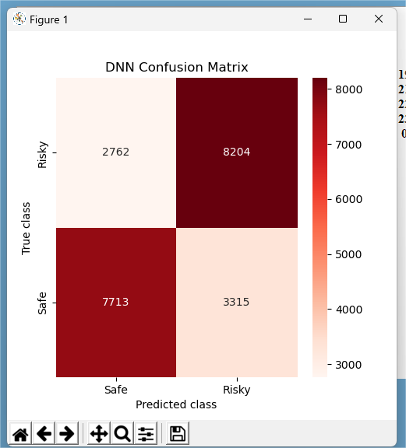

Slide 12
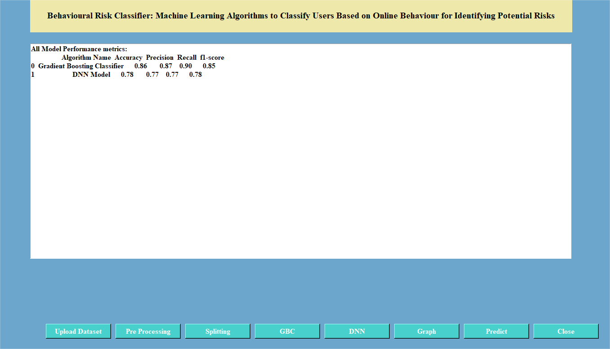
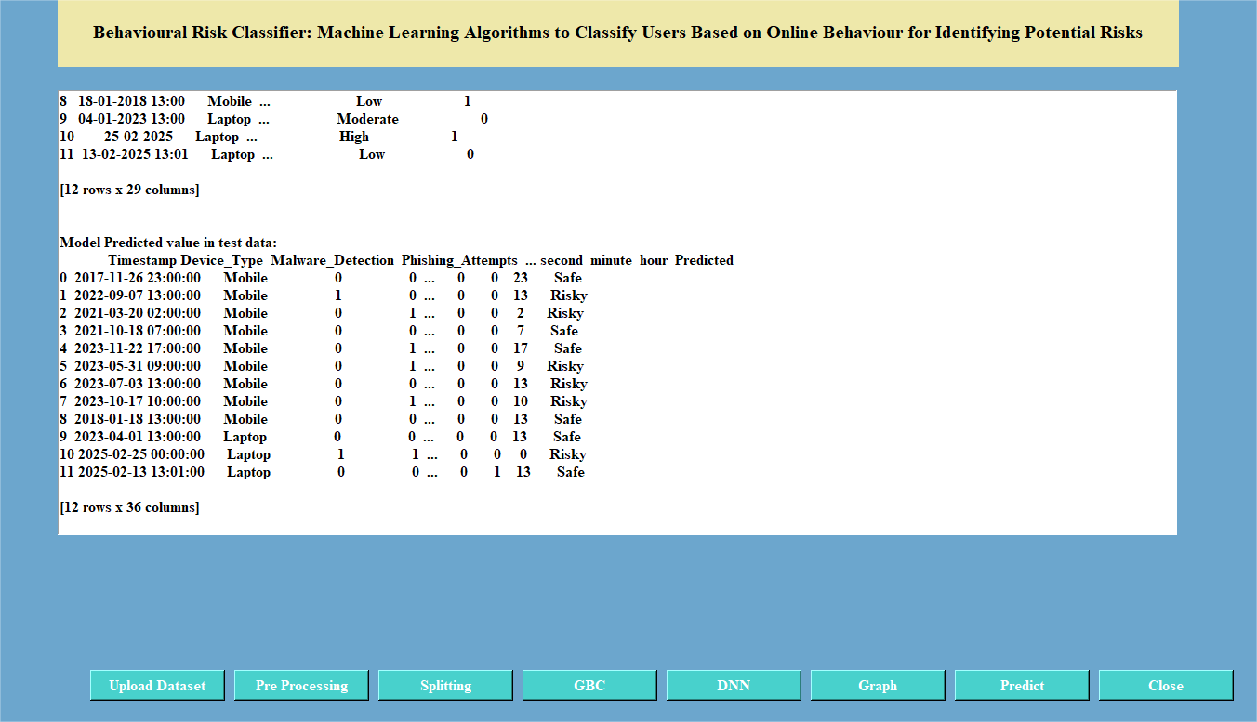

Slide 13
Conclusion
The research successfully analyzes cybersecurity behaviors and online activity patterns using machine learning techniques. By leveraging a dataset containing various security threats, online habits, and risk indicators, the study effectively identifies factors contributing to cybersecurity vulnerabilities.
The implementation of Gradient Boosting Classifier (GBC) and Deep Neural Network (DNN) classifiers enables accurate categorization of users based on their cybersecurity risk levels.
Future Enhancements
Real-time Deployment via a web-based API.
Explainable AI (XAI) for transparent decision-making.
Ensemble Learning for improved accuracy.

Slide 14
Reference
[1] Chen, C. C., Shaw, R. S., & Yang, S. C. (2006). Mitigating information security risks by increasing user security awareness: A case study of an information security awareness system. Information Technology, Learning & Performance Journal, 24(1).
[2] Johnston, A. C., Warkentin, M., McBride, M., & Carter, L. (2016). Dispositional and situational factors: influences on information security policy violations. European Journal of Information Systems, 25(3), 231-251.
[3] Donalds, C., & Osei-Bryson, K. M. (2020). Cybersecurity compliance behavior: Exploring the influences of individual decision style and other antecedents. International Journal of Information Management, 51, 102056.

Slide 15


